Slide 1



Stay up to date with
the life of our church
Simply hold your phone to the tap card
until a link appears.

Slide 2


Stay connected at <Church Name>
Simply hold your phone to the tap
card until the link appears.

Slide 3

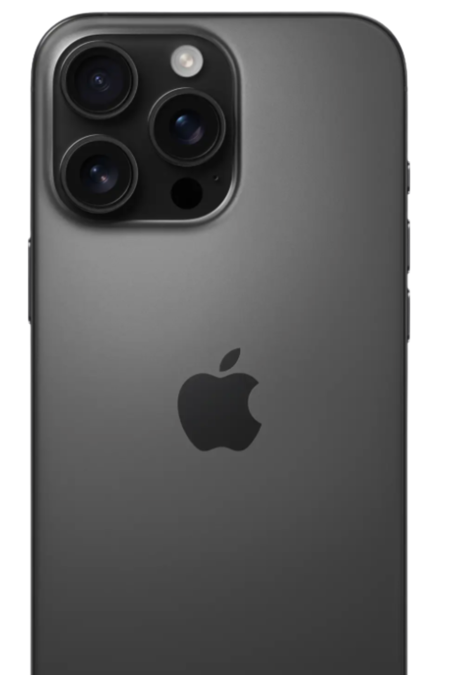



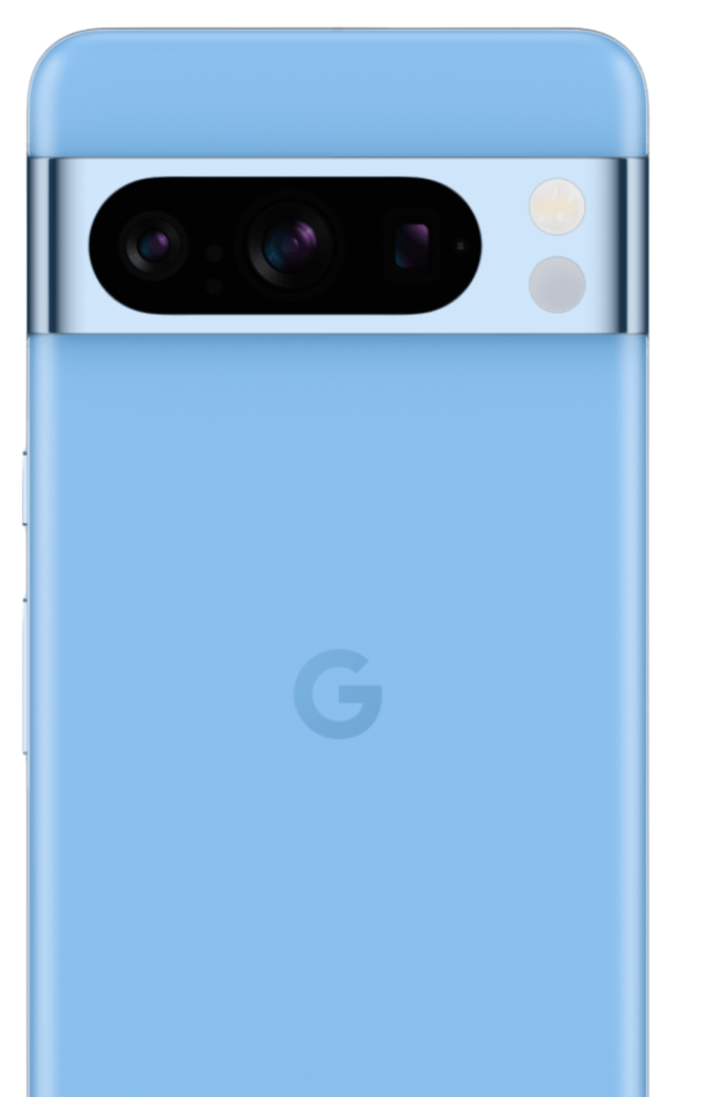


Apple or Android
Where to tap?
iPhone
NFC Receiver
If link does not display:
Android
NFC Receiver
✓ Did you tap long enough?
✓ Is your NFC setting on?
✓ Does your phone have cell or wifi service?

Slide 4


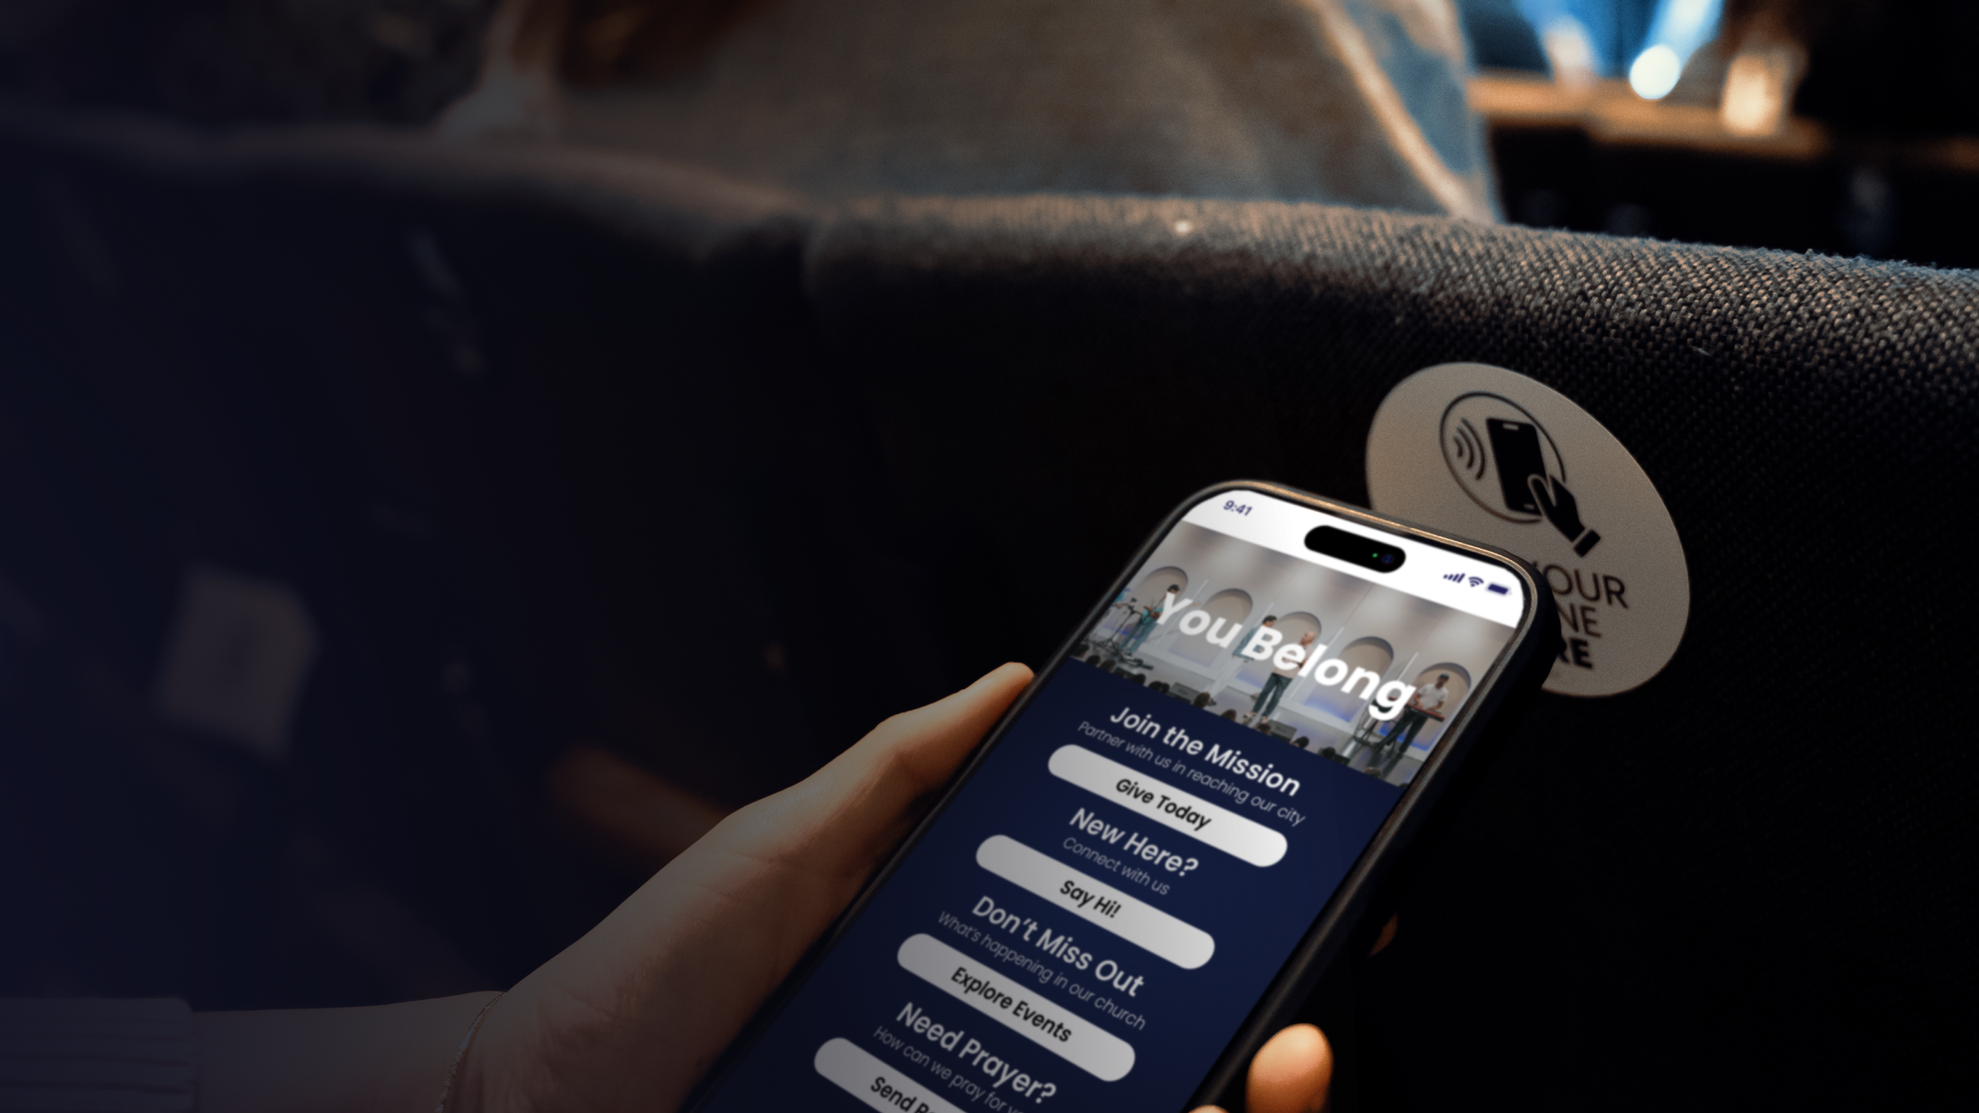
Stay connected at <Mannahouse>
Simply hold your phone to the tap card until the link appears.
REACH01

Slide 5


Apple or Android
Where to tap?
iPhone
NFC Receiver
Android
NFC Receiver
If link is not displaying:
✓ Did you tap long enough?
✓ Is your NFC setting on?
✓ Does your phone have cell or wifi service?

